Slide 1

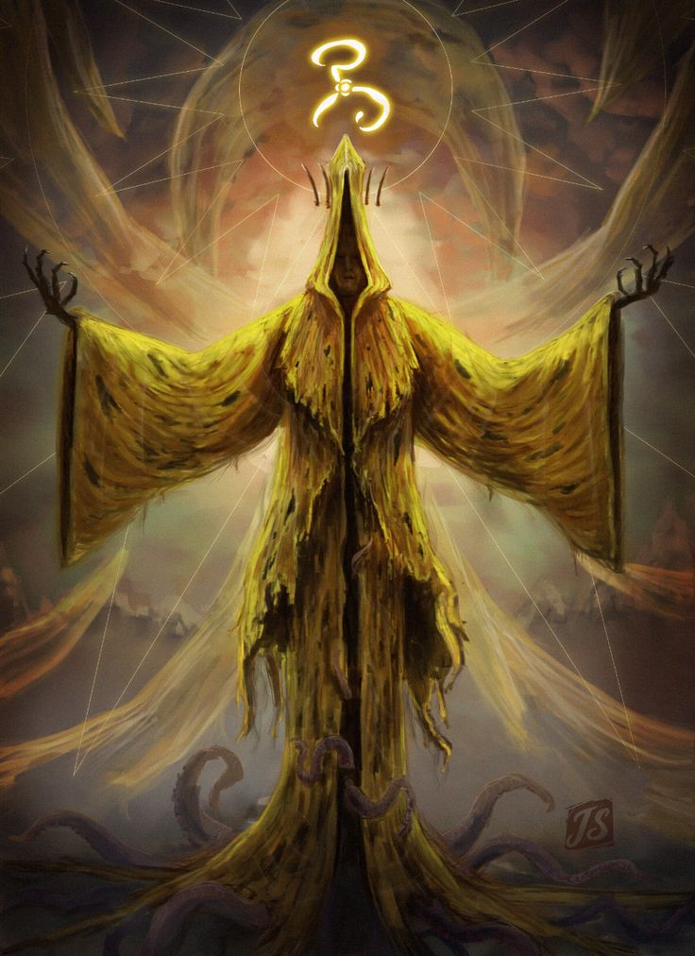
Broken loop
2.5 platformer
Target audience 15-25
“fans” –lovecraftianhorror

Slide 2
2.5d
2.5D, perspective refers to gameplay or movement in a video game environment that is restricted to a two-dimensional plane with little to no access to a third dimension in a space that otherwise appears to be three-dimensional and is often simulated and rendered in a 3D digital environment.

Slide 3
Features we might include
Things change when they die
Puzzles
Collectibles
Dash/wall jump
Secondary Features
Journal Mechanic
Hallucinations/sanity
Randomisation

Slide 4

Strengths
we are creative - Heavily design element in the group
We all have a general idea for what we’re pursuing
Our ideas are easily scalable

Slide 5

Weaknesses
No programming-focused members in team
Lack of experience within the genre
Lots of overlap within team, leading to similar roles

Slide 6

Opportunities
Some of us get to work with a completely new genre
Get to work on new techniques like mocap and foley
Working in an organized collaborative team

Slide 7

Threats
Lack of organization and bad time management could collapse the project
Possible snowballing of project scope

